Slide 1

Data 211 Course Project
Mike Earl

Slide 2
Intro and Background
I work a 12 hour rotating shift in a 24/7 control room.
We work alternate between three- and four-days weeks.
We are have a 12 week rotation that consists of 8 weeks on days and 4 weeks on nights.

Slide 3
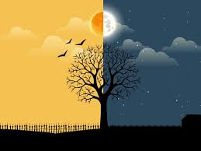
Question
I feel like I get a lot less sleep when I work my night rotations, is this actually the case?
H0: mu(Nights)=mu(Days), Ha: mu(Nights)!=mu(Days)

Slide 4
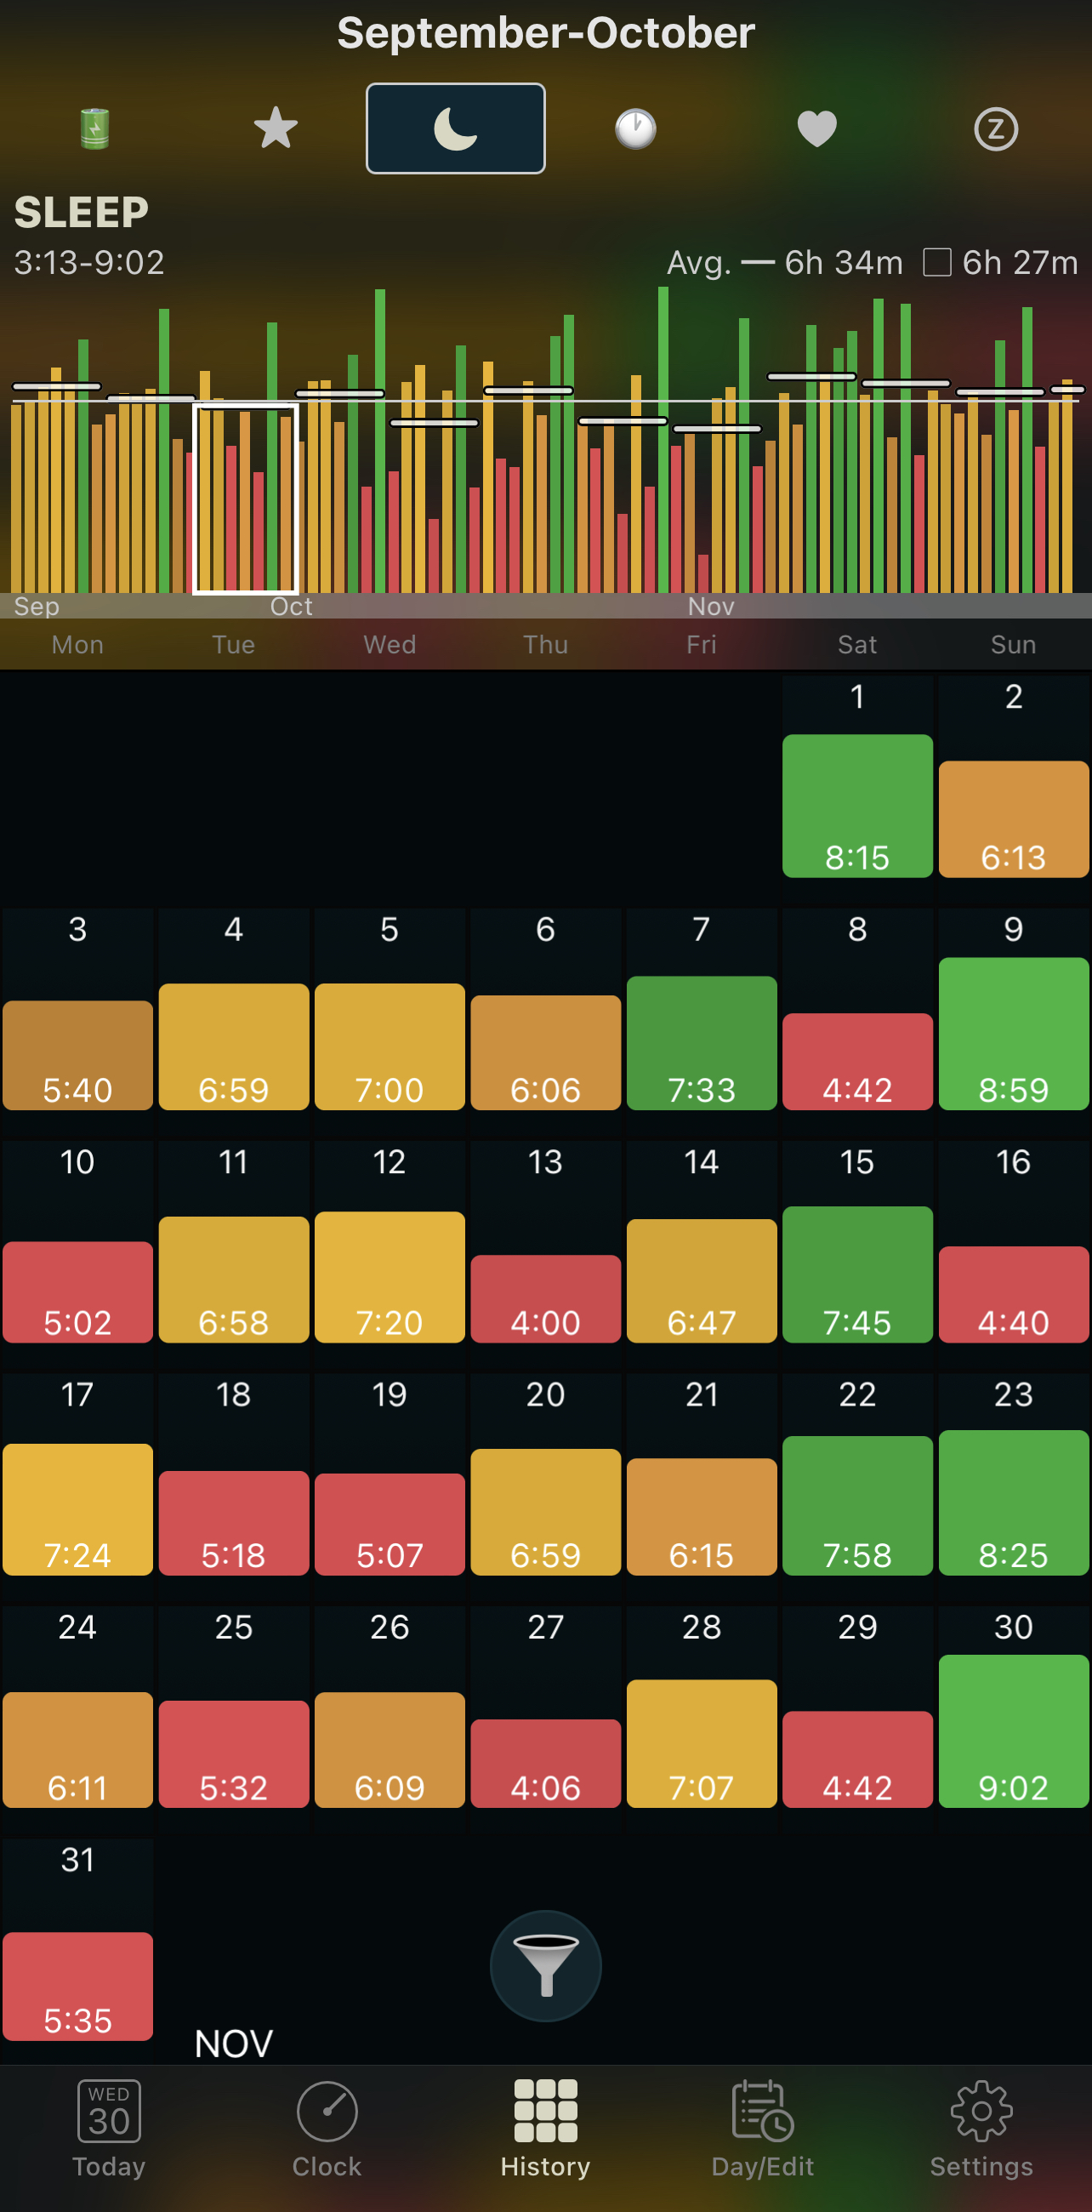
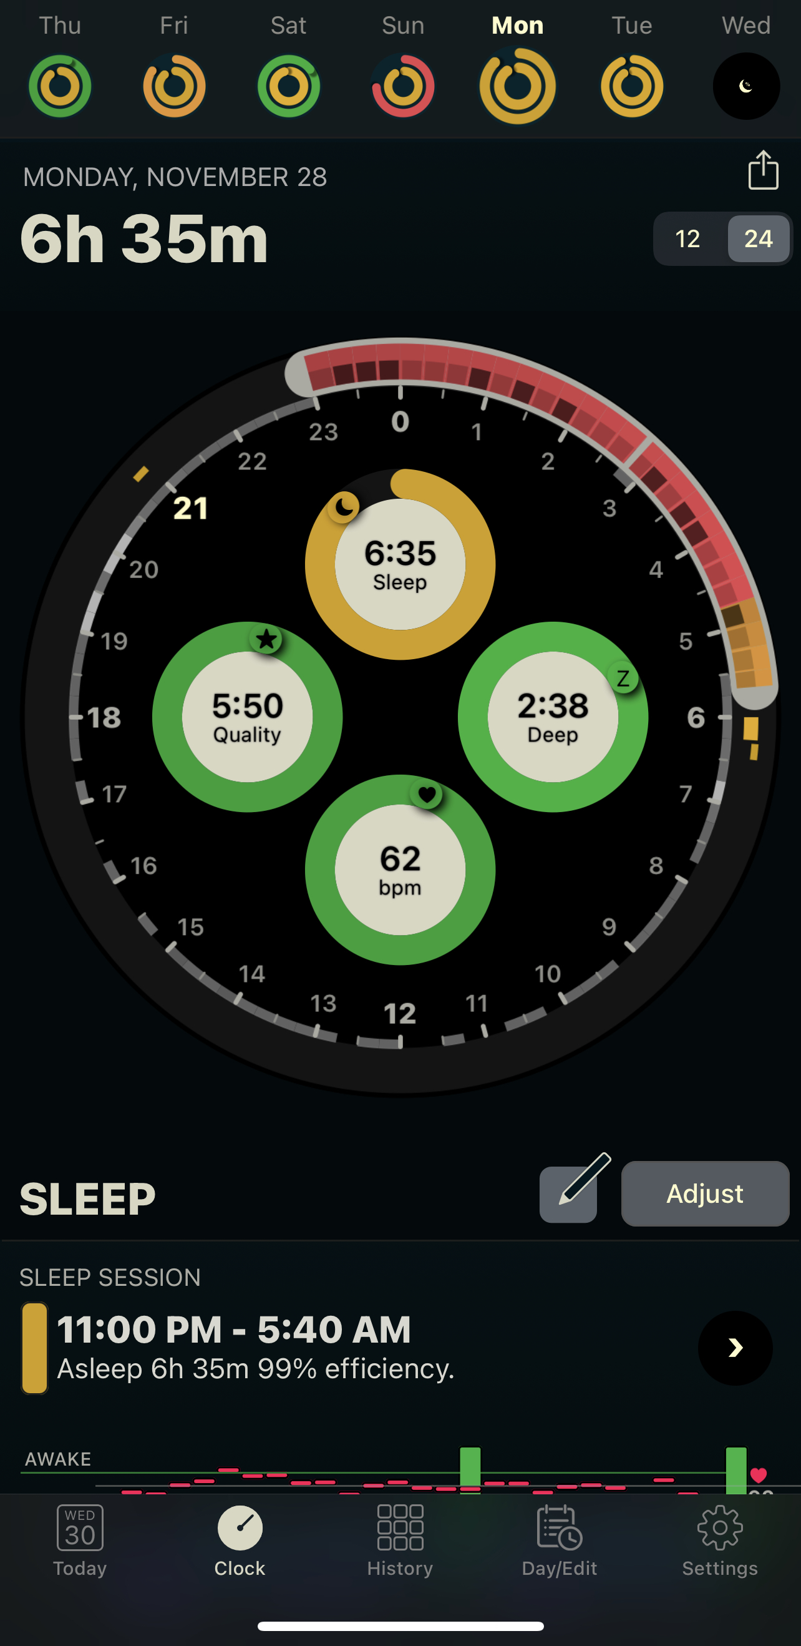
Sleep Tracking
I have been tracking my sleep since around May of 2018 with my Apple Watch and AutoSleep.
Always wearing my watch makes it more accurate than if I was to try and figure out what time I went to sleep each night.
I exported a years worth of data into an Excel sheet.
One issues; my sleep varies widely day to day regularly.

Slide 5
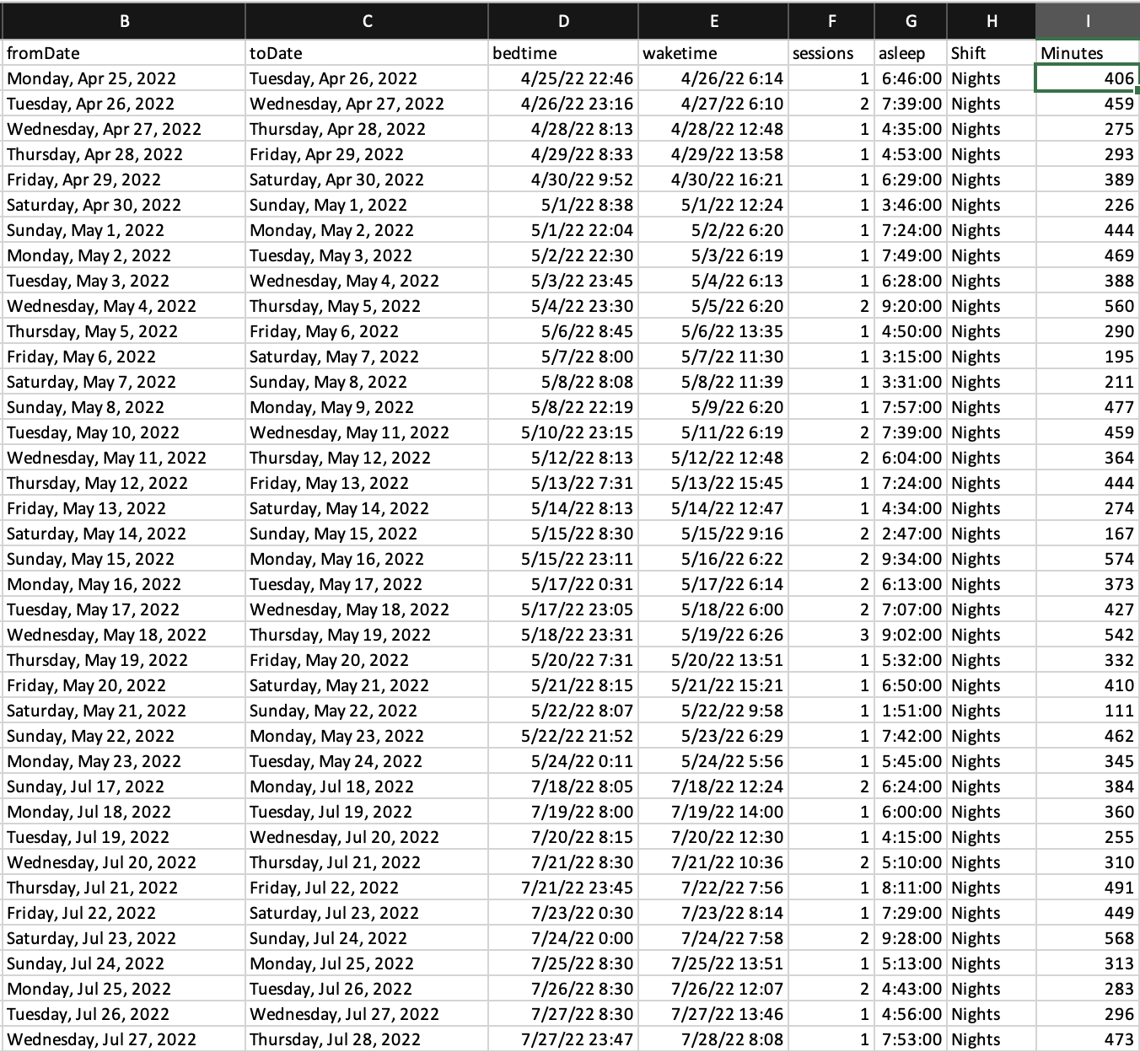
Data Wrangling
I cross checked the dates against my work calendar to add a shift group for each day. Then I converted the time from hours and minutes to just minutes.

Slide 6
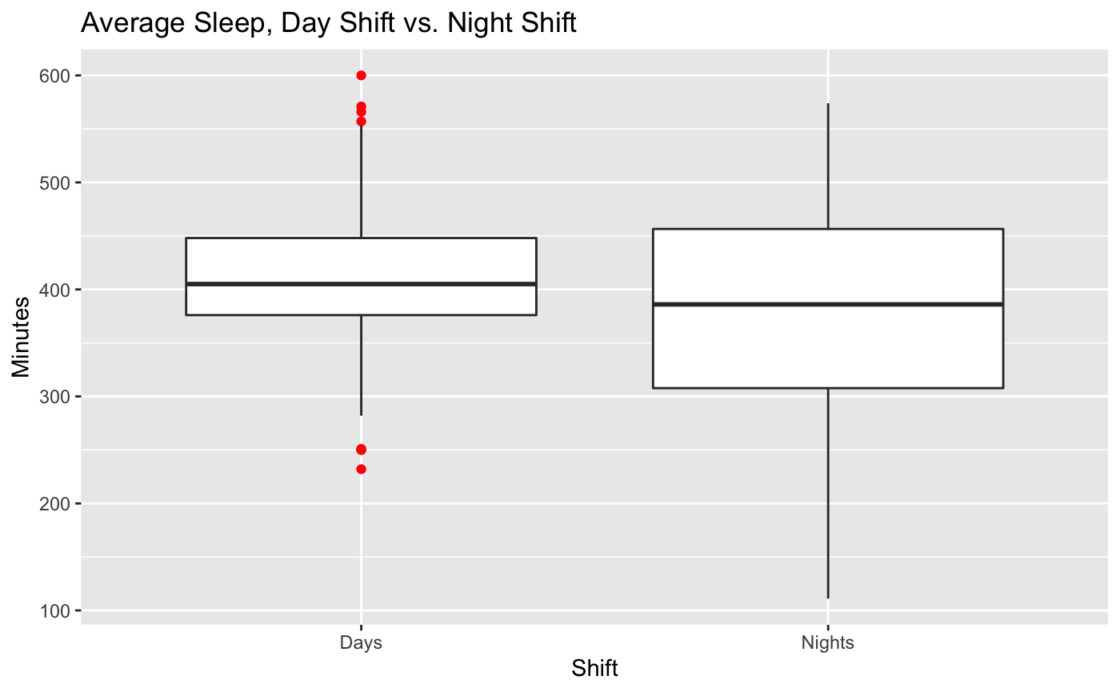
Averages
I found that my day shift average was 411.03 minutes(6 hours and 51 minutes.
My night shift average was 379.33 minutes (6 hours and 19 minutes.)
On average I sleep 32 minutes less each night when I am on my night shift rotation.
Side note; my overall average was 402.30 minutes (6 hours 42 minutes) for the the year. The national average (according to thegoodbody.com) is 6 hours 48 minutes.

Slide 7
Conclusion
In the end with a p value of 0.0062, I rejected the null hypothesis and concluded there is evidence to prove I get less sleep on night shifts.

